Slide 1
Team Deliverable 2
Presentation
By Crazy Frog Incorporated.

Slide 2
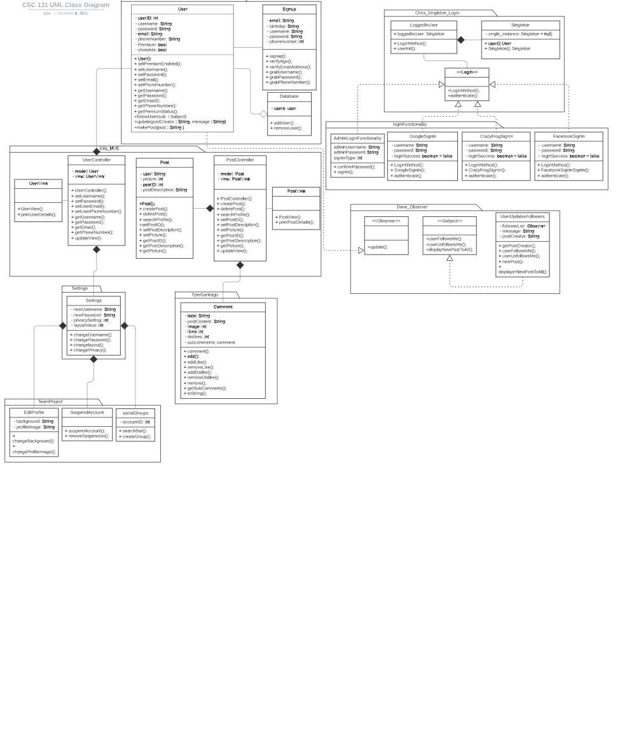
UML Class Diagram

Slide 3
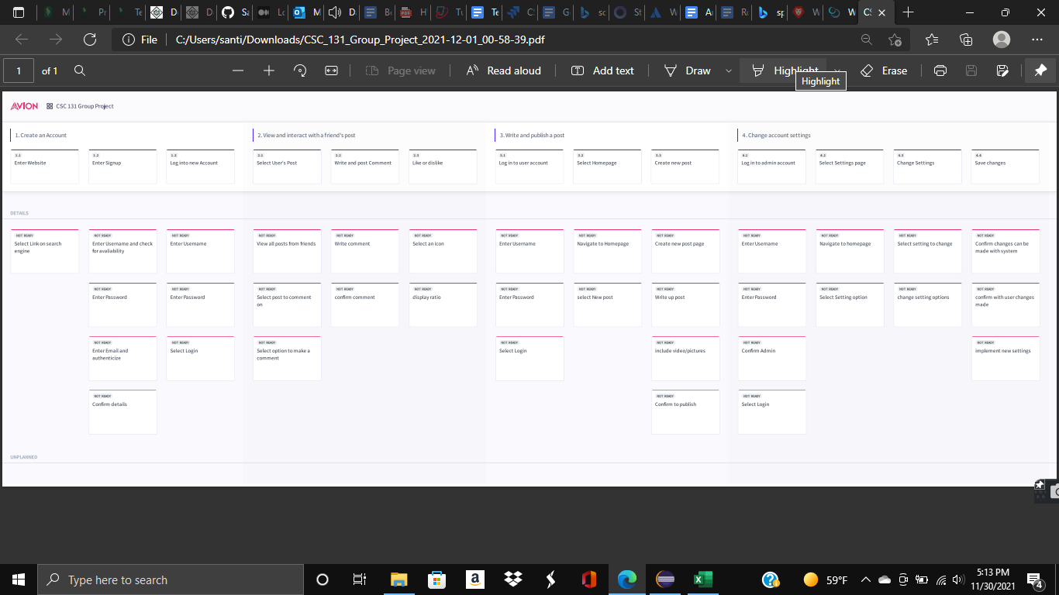

Slide 4
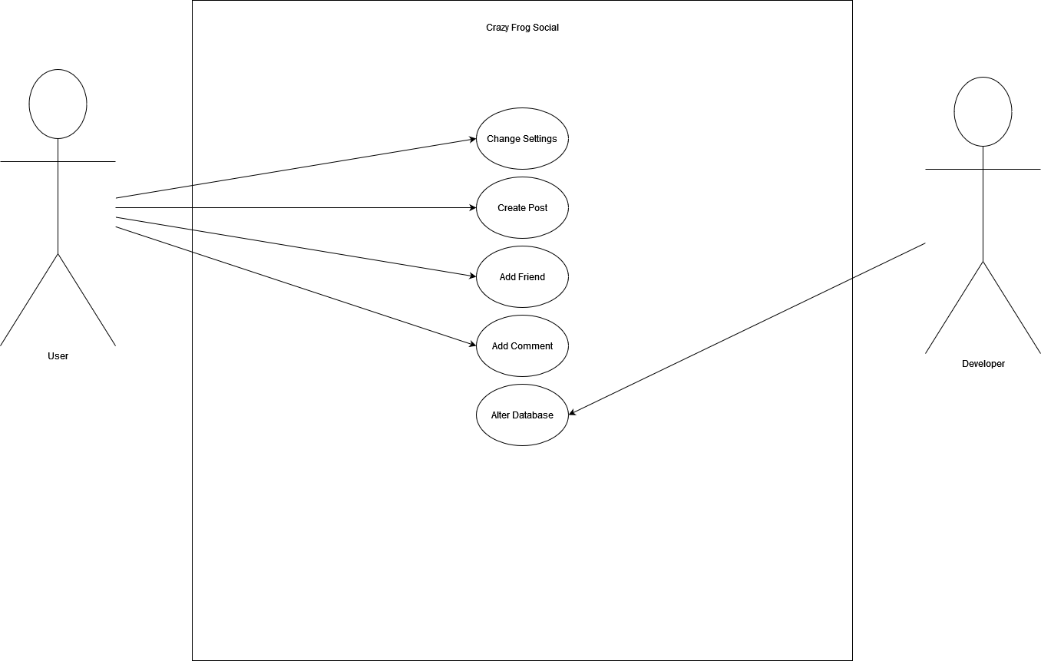
UML Use Case Diagram

Slide 5
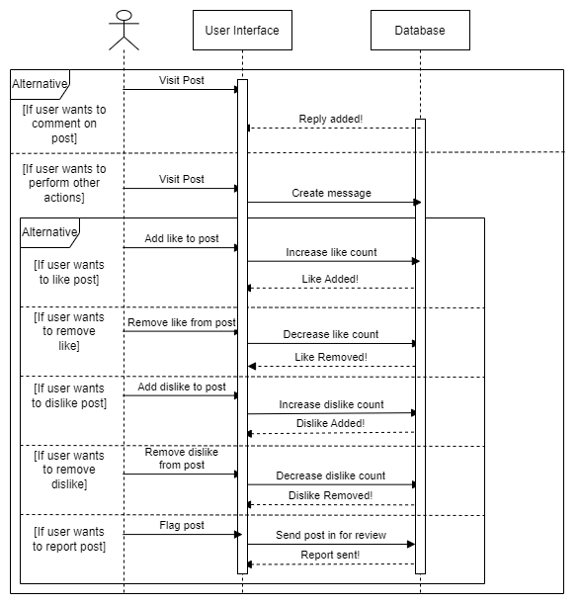
UML Sequence Diagram

Slide 6
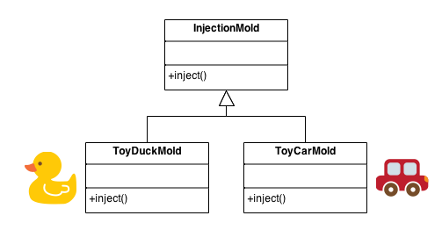
Design Pattern 1 - Factory Method: Santiago - Login.Java and other related classes:
Notes:
Injection molding presses demonstrate this pattern. Manufacturers of plastic toys process plastic molding powder, and inject the plastic into molds of the desired shapes. The class of toy (car, action figure, etc.) is determined by the mold.
-Centralize class selection code.
-To encapsulate object creation.
-Don’t know ahead of time what class object you need.
-When all the potential classes are in the same class subclass hierarchy.

Slide 7
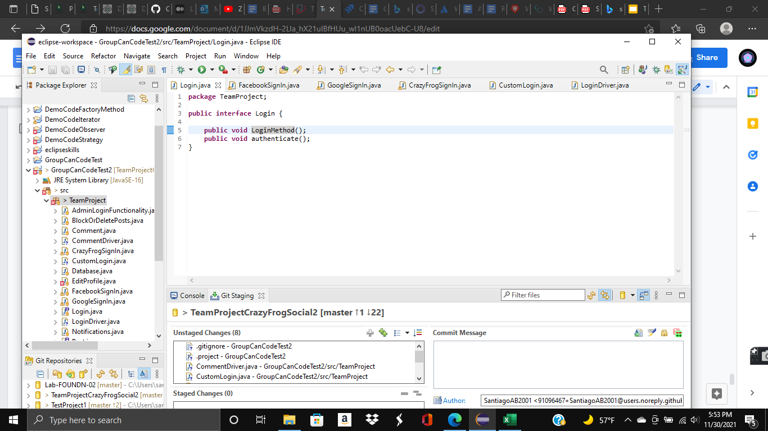
Design Pattern 1 - Factory Method: Santiago - Login.Java and other related classes:
Notes:
Define an interface for creating an object, but let subclasses decide which class to instantiate.
In Factory pattern, we create object without exposing the creation logic to the client and refer to newly created object using a common interface.

Slide 8
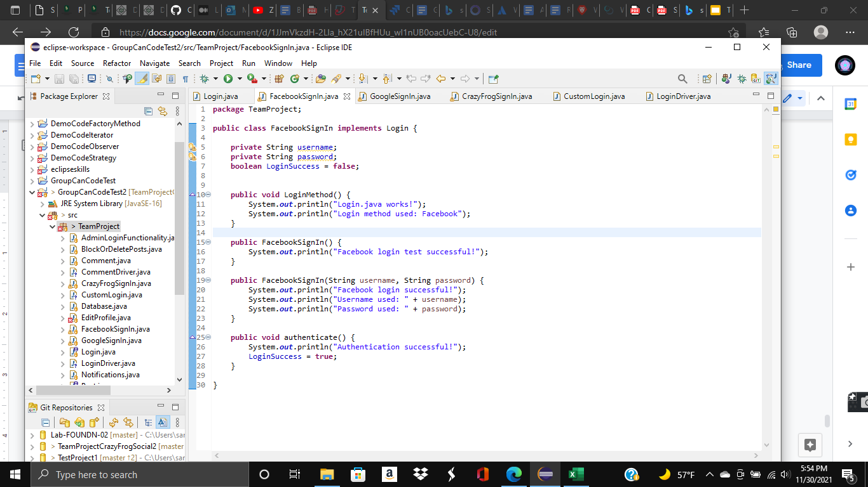
Design Pattern 1 - Factory Method: Santiago - Login.Java and other related classes:

Slide 9
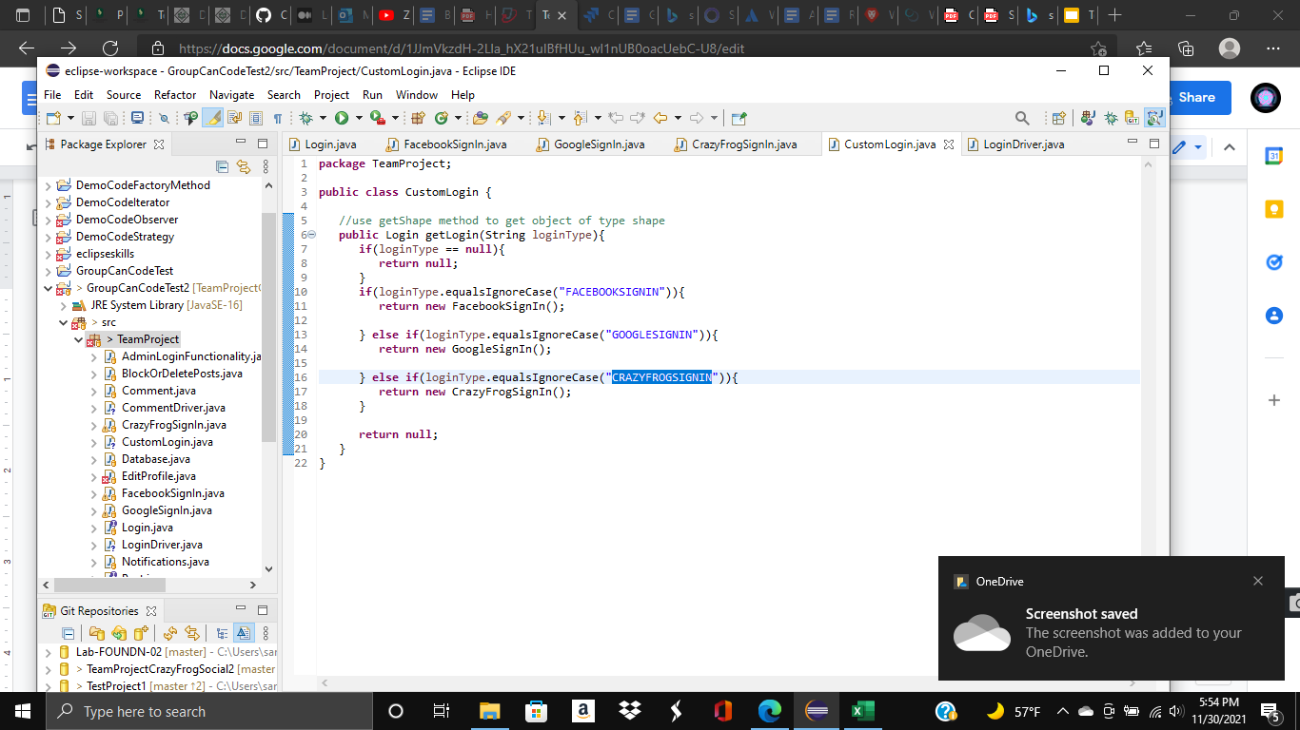
Design Pattern 1 - Factory Method: Santiago - Login.Java and other related classes:

Slide 10
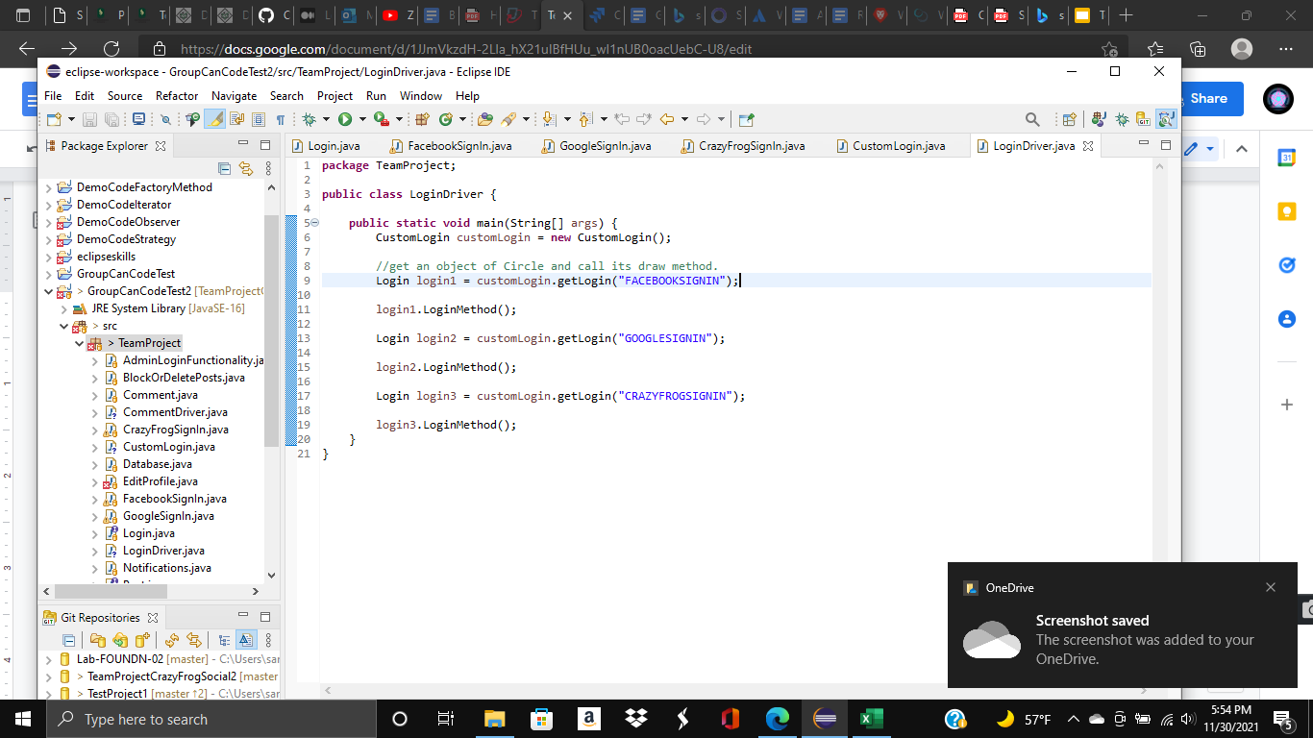
Design Pattern 1 - Factory Method: Santiago - Login.Java and other related classes:

Slide 11
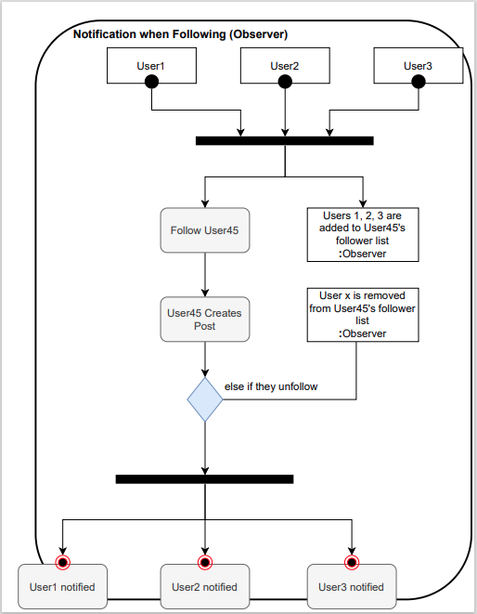
Design Pattern 2: Observer
Activity Diagram:

Slide 12
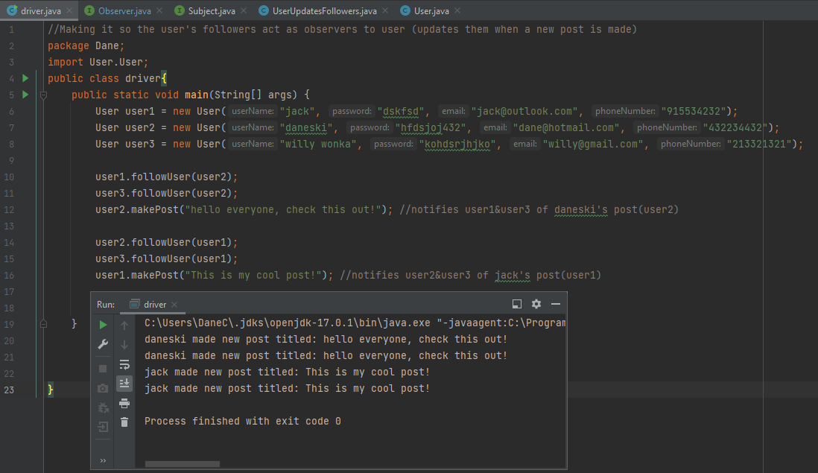
Design Pattern 2: Observer

Slide 13
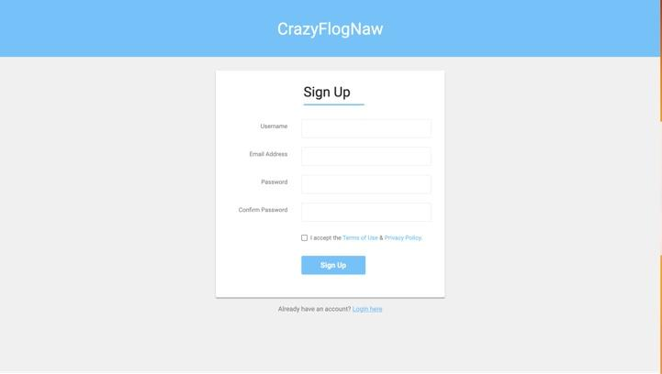
UI- Sign Up Page

Slide 14
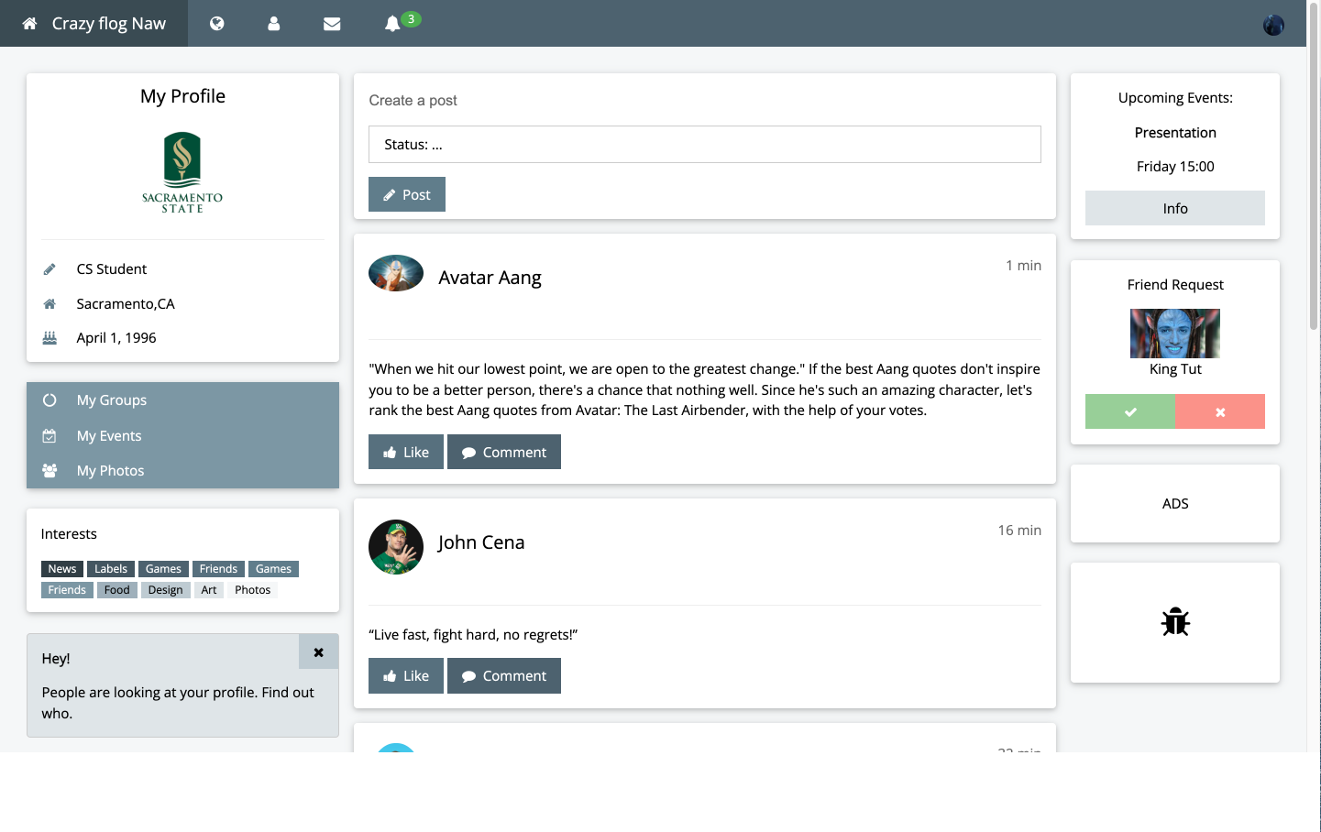
UI - Main Page

Slide 15
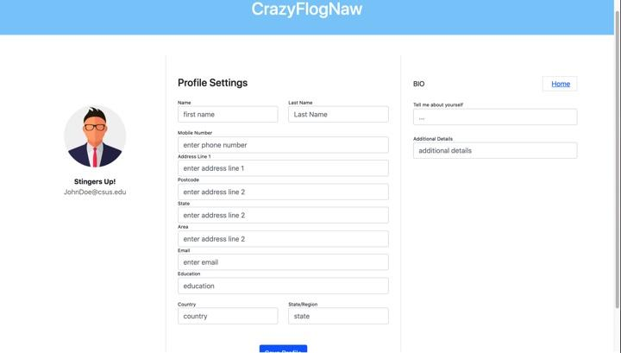
UI- Settings Page

Slide 16
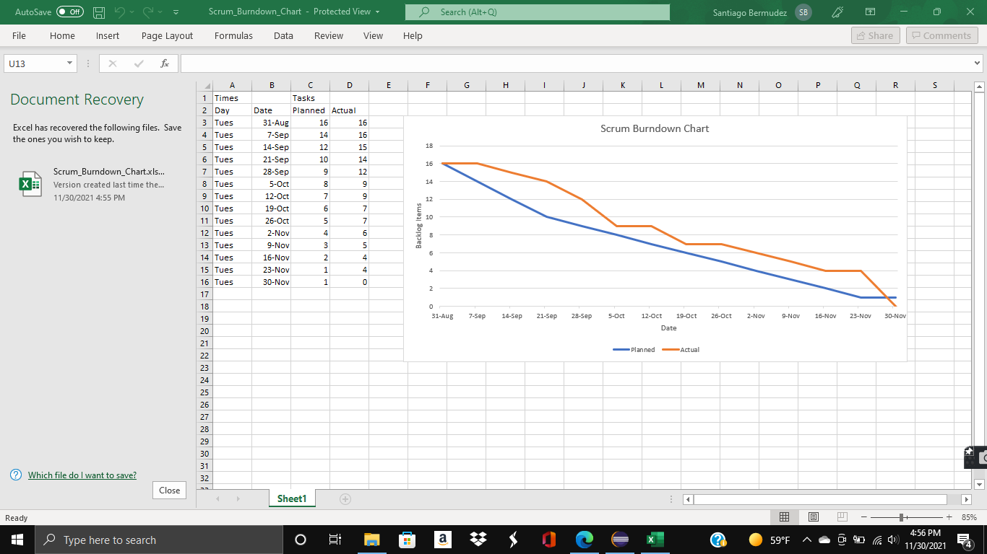
Scrum Burndown Chart

Slide 17
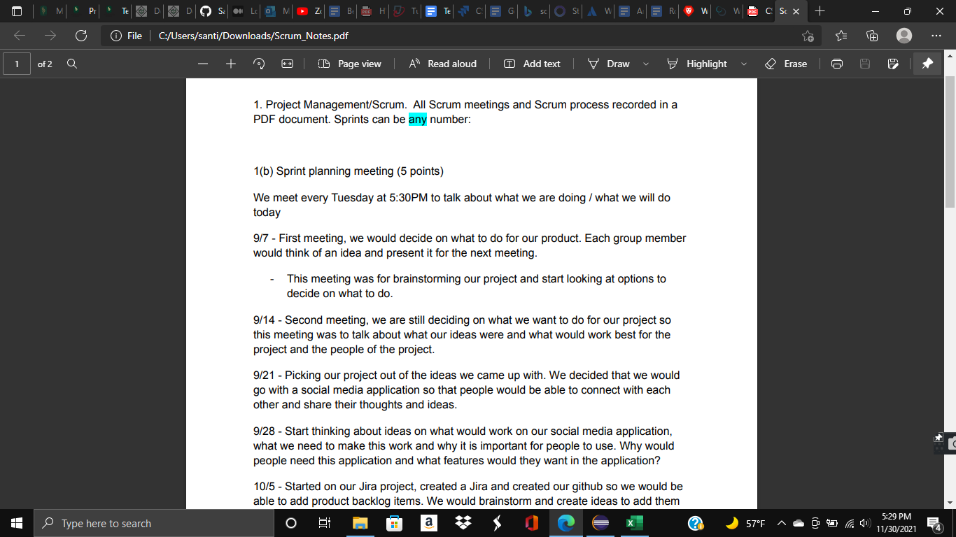
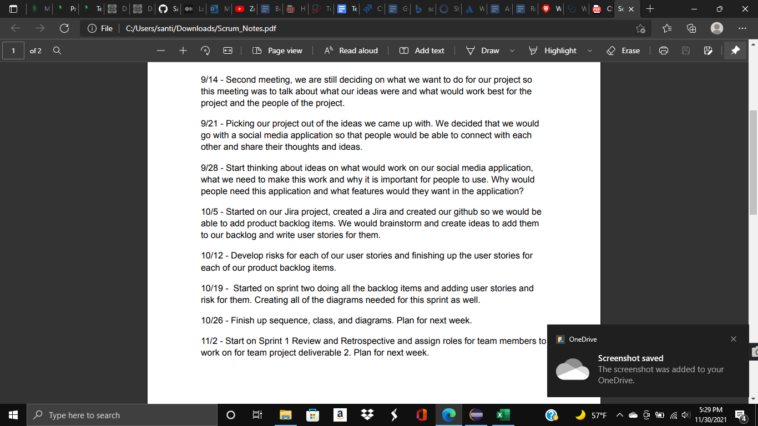
Scrum Meeting Notes

Slide 18
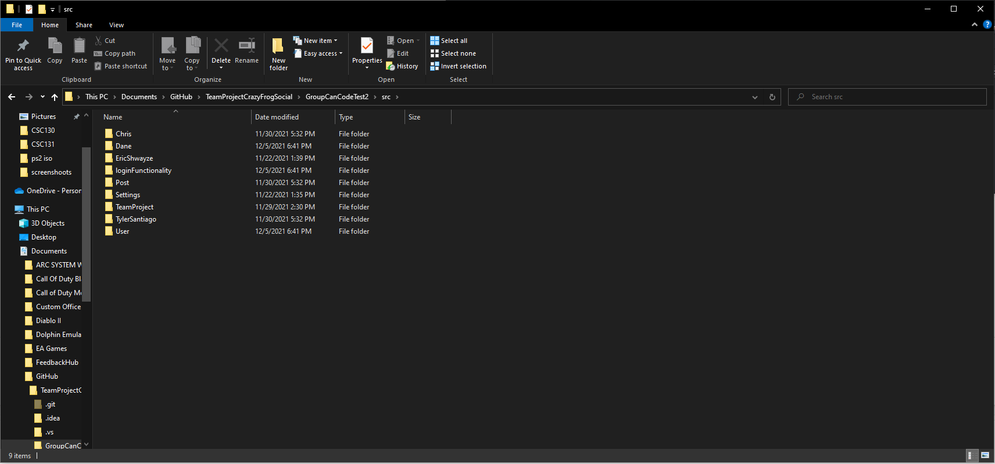
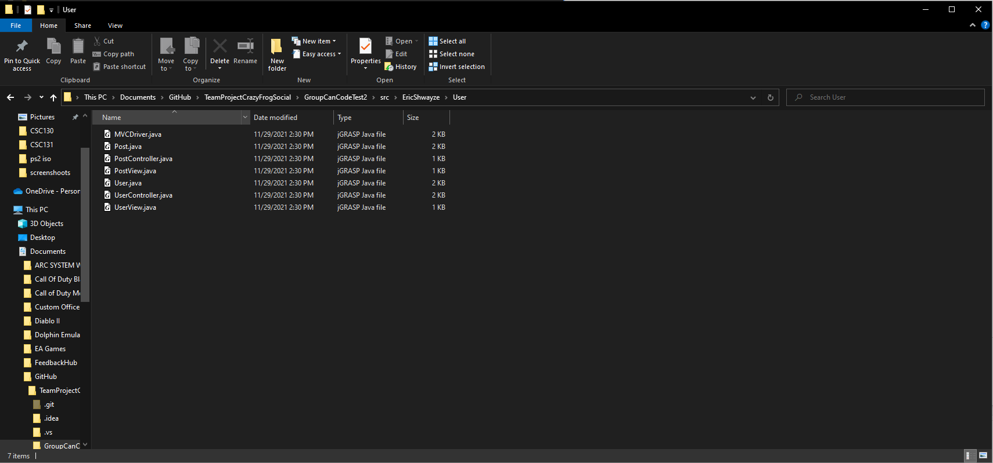
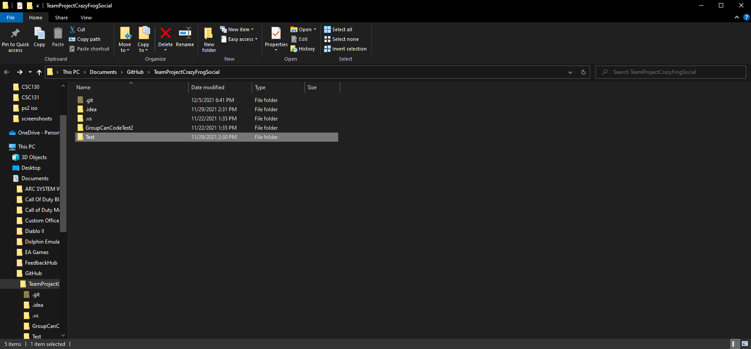
High Cohesion and Low Coupling

Slide 19
Video Link:
https://youtu.be/gY21wu7P2VU

